Slide 1
Intermediate Education Ontology

Slide 2
Team Leader: Sehrish Noreen – BSEF19M014
Team Member: Rabia Ehsan – BSEF19M013
Team Member: Kiran Anwar – BSEF19M018
Project Advisor: Mr. Fahad Maqbool
Education Domain Advisor: Mr. Abdul Ghafoor
Project Manager: Dr. Muhammad Illyas

Slide 3
1. Ontology Introduction 2. Educational Domain Introduction 3. Methodology (With Prototype) - Initiation - Reuse - Design - Implementation 4. Supportive Activities

Slide 4
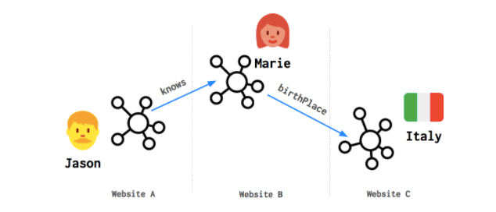
Ontology introduction:
Ontology is the basis for semantic web.
A knowledge network made up of linked data.
relationships or connections between data from different data sources such as databases and the Web.
Examples of large linked data sets are DBpedia and Wikidata.
FAIR:
F: Findable
A: Accessible
I: Interoperable
R: Reusable
https://wordlift.io/blog/en/entity/linked-data/

Slide 5
Ontology introduction:
Web 1.0 | Web 2.0 | Web 3.0
Web pages | Social web | Web of data
Read only | Read and write | Executable web
No interoperability | No interoperability | Interoperability

Slide 6
EDUCATIONAL DOMAIN INTRODUCTION:
Education
Primary
Middle
Matric
Intermediate
Under/Post
Graduate
1-5
6-8
9-10
13-->
1st year
2nd year

Slide 7
EDUCATIONAL DOMAIN INTRODUCTION:
Example

Slide 8

Student

Slide 9

Takes_Admission_In
Student
College

Slide 10

Program
Offers
Takes_Admission_In
Student
College

Slide 11
Program
Enrolls_In
Offers
Takes_Admission_In
Student
College

Slide 12

Syllabus
Covers
Enrolls_In
Program
Offers
Takes_Admission_In
Student
College

Slide 13

BISE
Takes
Syllabus
BISE Exam
Covers
Gives
Enrolls_In
Program
Offers
Takes_Admission_In
Student
College

Slide 14

BISE
Takes
Syllabus
BISE Exam
Announces
Covers
Gives
Enrolls_In
Gets
Program
BISE Result
Offers
Takes_Admission_In
Student
College

Slide 15

BISE
Takes
Syllabus
BISE Exam
Announces
Covers
Gives
Enrolls_In
Gets
Program
BISE Result
Offers
Takes_Admission_In
Student
Provides
College
Facilities

Slide 16
BISE
Takes
Syllabus
BISE Exam
Announces
Covers
Gives
Enrolls_In
Gets
Program
BISE Result
Offers
Takes_Admission_In
Avails
Student
Provides
College
Facilities

Slide 17
BISE
Takes
Syllabus
BISE Exam
Announces
Covers
Gives
Enrolls_In
Gets
Program
BISE Result
Offers
Takes_Admission_In
Avails
Student Name
Roll No.
Gender
Student
Provides
College
Facilities

Slide 18
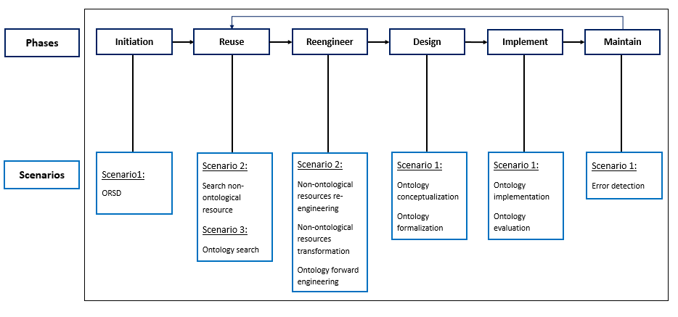
Methodology:
Methodology is the sequence of steps we take to engineer/re-engineer our ontology. Different methodologies are available for ontology engineering.
We will use NeON methodology.
It provides 9 scenarios for ontology engineering.
( 5-phase Iterative Incremental model)

Slide 19
Initiation
Motivation:
We are going to develop this ontology to clear the students’ queries about 2-year inter- programs, before and after, they join college.
Intermediate education consists of 11th and 12th classes.
The purpose of the Intermediate Education ontology is to provide students with counselling about inter programs.

Slide 20
1. Initiation (Cont.)
Scope:
What’s included?
- Intermediate Education ontology is specific to the Intermediate level
- (11th and 12th classes, 2-year).
- The ontology includes knowledge related to Intermediate courses only.
What’s not included?
- It does not include knowledge about levels, other than intermediate.
- (Primary, Secondary, A/O Levels, and Higher levels).
It limits to Intermediate Education in the Punjab province of Pakistan (students under BISE-Punjab).

Slide 21
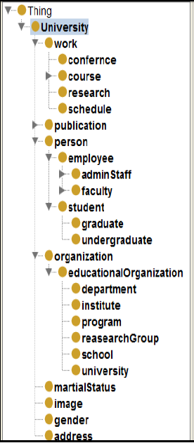
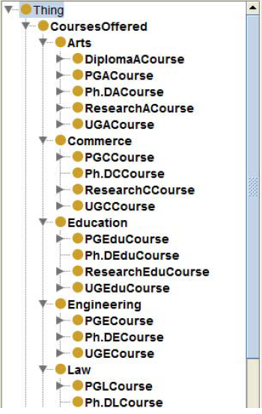
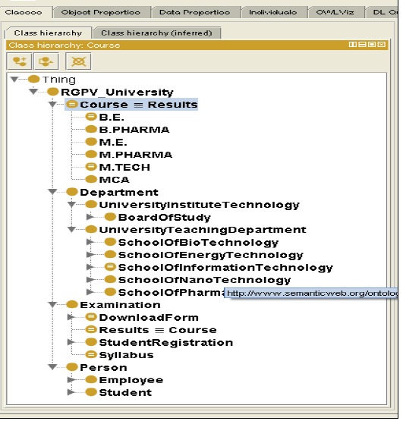
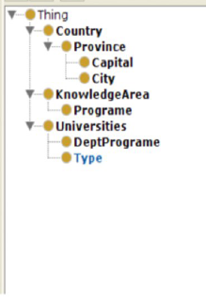
2. Reuse (Searching Related Work)
University of Palestine | University (Hyderabad, India) | Rajiv Gandhi University | University

Slide 22
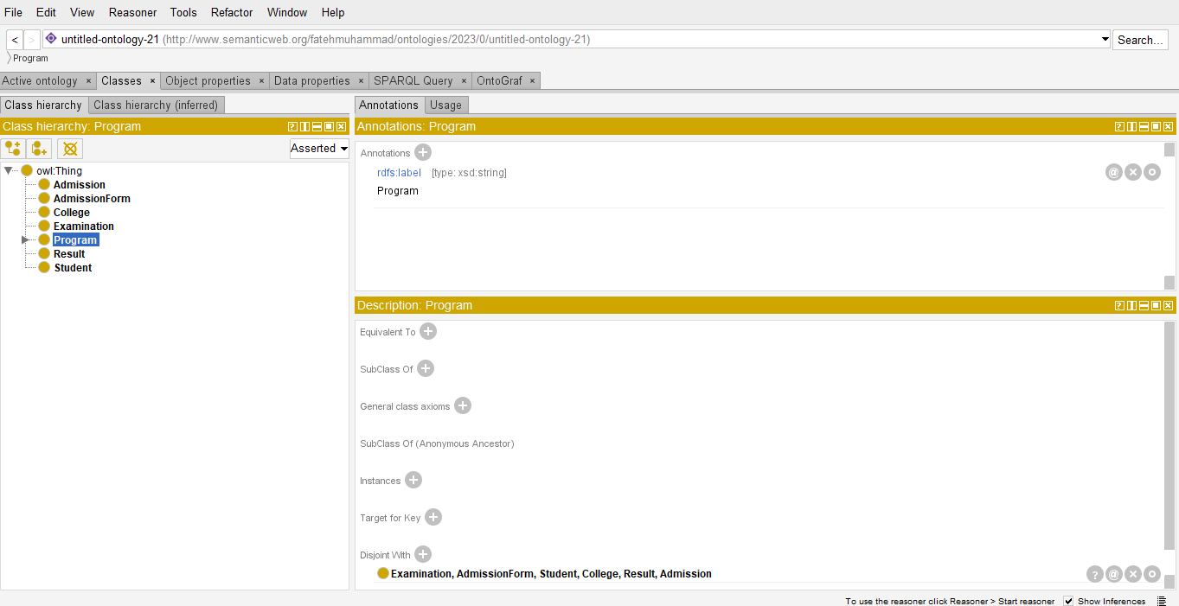
Intermediate Education Ontology Prototype, to describe the next Phases

Slide 23

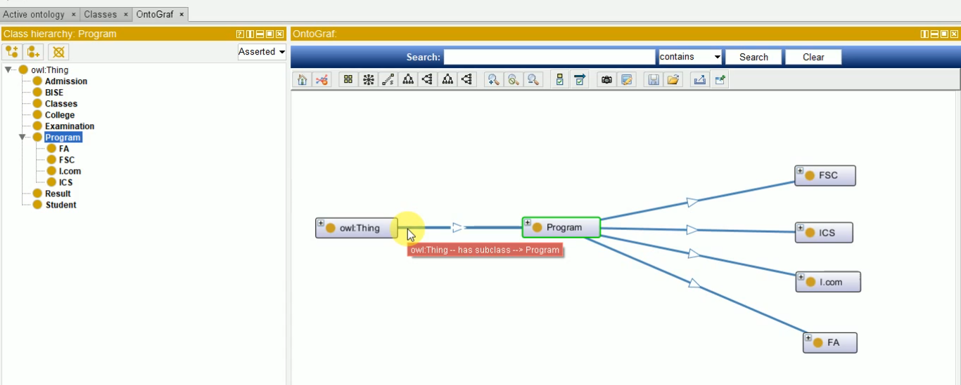

3. Design (Cont.)
Protege:
To Design Ontology
Create classes

Slide 24
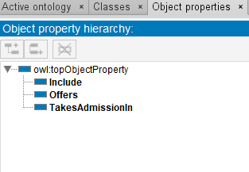
3. Design (Cont.)
Protege:
To Design Ontology
Create classes
Relationships among classes

Slide 25

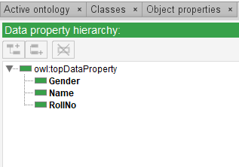
3. Design (Cont.)
Protege:
To Design Ontology
Create classes
Relationships among classes
Data Properties

Slide 26


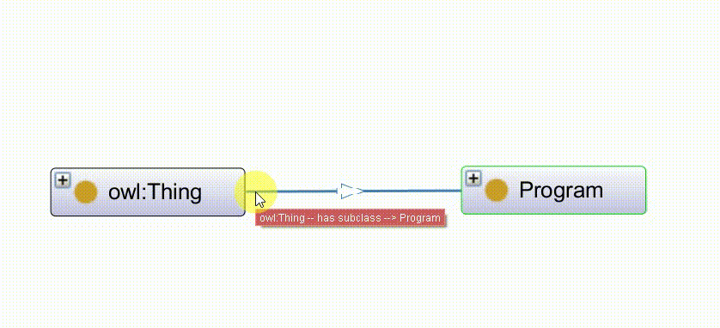
4. Implementation
Implementation and Evaluation:
1. Owl Language:
To Implement Ontology
(Triples)

Slide 27

4. Implementation
Implementation and Evaluation:
1. Owl Language:
To Implement Ontology

Slide 28

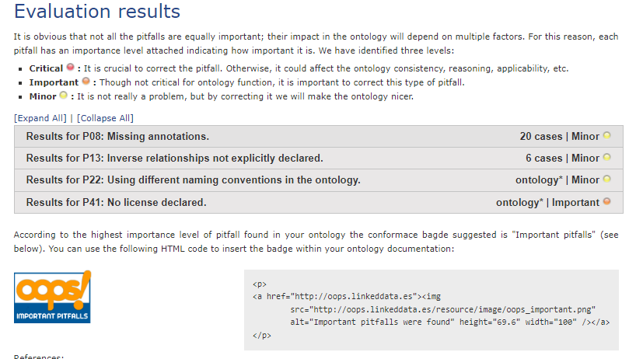
4. Implementation (Cont.)
Implementation and Evaluation:
2. OOPS Pitfall Scanner:
To Evaluate Ontology

Slide 29

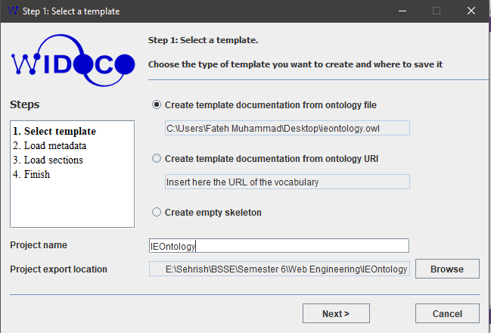
Supportive Activities and Tools:
For ontology documentation.

Slide 30

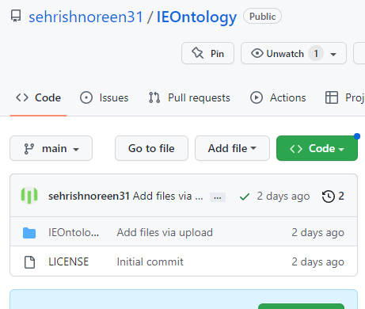
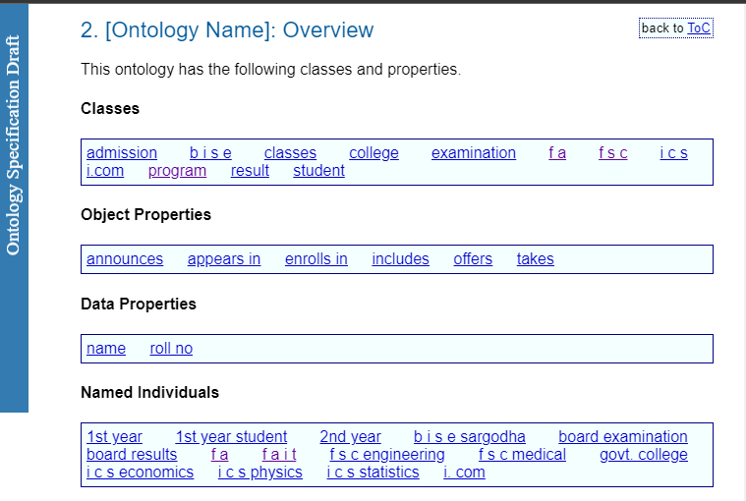
Supportive Activities and Tools (Cont.):
Platform for publishing the ontology Documentation.

Slide 31

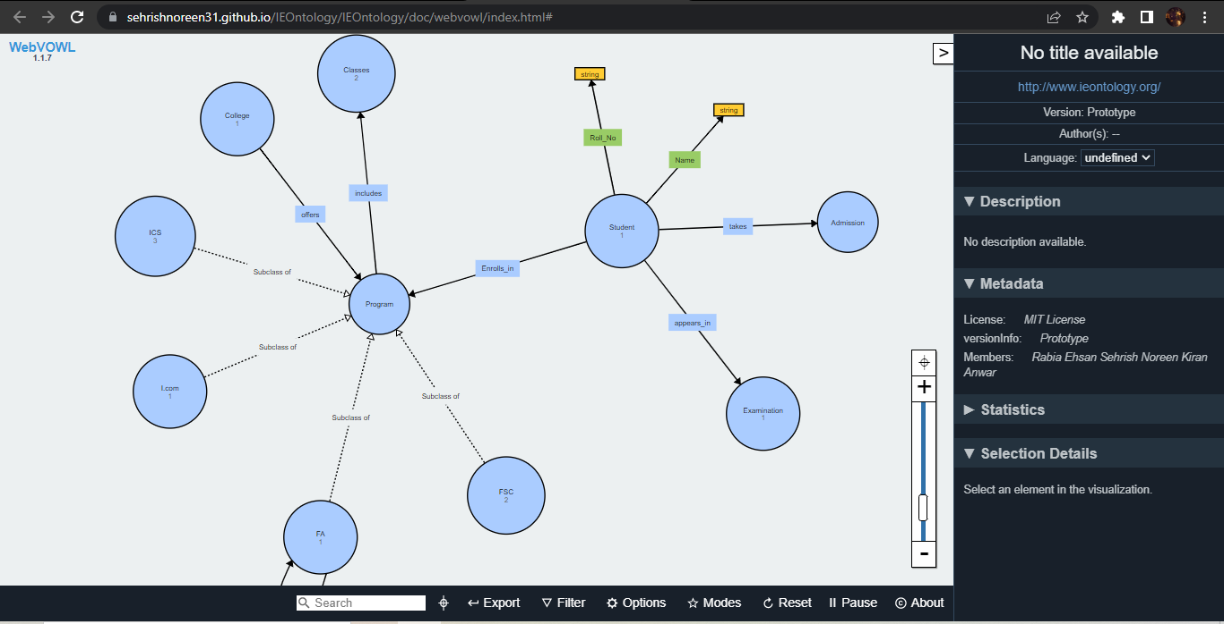
Supportive Activities and Tools (Cont.):
For visualization of ontology

Slide 32

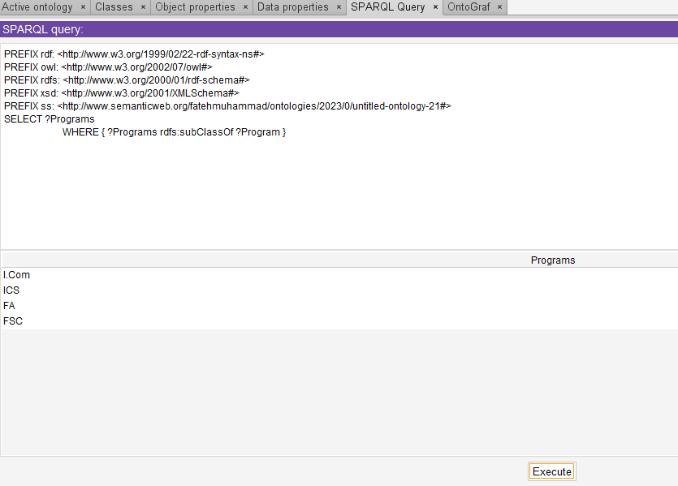
Supportive Activities and Tools (Cont.):
Language to query data from the ontology.

Slide 33
End

